Slide 1
Chapter 6
Accountability an Workplace Relationships

Slide 2
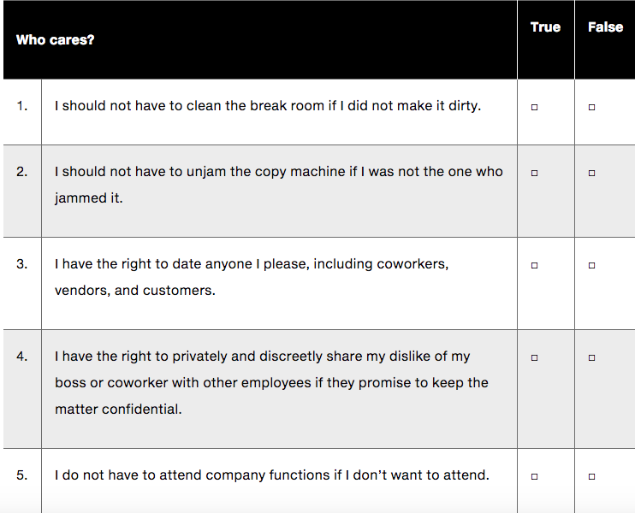

Slide 3
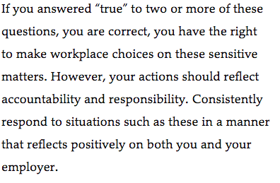

Slide 4
Accountability and Empowerment
Accountability – taking personal responsibility for ensuring your work reflects positively on both you and your company

Slide 5
Empowerment
Pushing power and decision making to the individuals who are closest to the customer in an effort to increase quality, customer satisfaction, and profits.
Telling someone to do something is different than teaching someone the correct behavior (training)

Slide 6
Responsibility
Accepting the power that is being given to you
The concept of empowerment and responsibility are useless without accountability

Slide 7
Accountability
You will report back to whoever empowered you to carry out a specific responsibility
In businesses employees are accountable to each other, their bosses, their customers, and their investors

Slide 8
How to gain respect and credibility
Ask for and assume new tasks
Ask your boss to teach you new tasks
Assume responsibility for these new tasks and report back on your performance
Each project must have a measurable goal

Slide 9
As you increase workplace responsibilities
1. ask for assistance
2. when you make mistakes, apologize if necessary and do not blame others
Determine what went wrong and why
Learn from mistakes
Do better in the future

Slide 10
Personal Accountability
Come to work with a positive attitude
Give 100% effort
Be on time
Do what is expected
Do not miss work unless you are truly ill
Reserve personal leave days for emergencies

Slide 11
During Work Hours
Do not surf the internet
Do not waste company time for personal business
When an employee is constantly late, absent, or not completing their duties other employees must assume the responsibilities of this employee
This leads to poor workplace relationships and
Affects productivity

Slide 12
Workplace Relationships
Behave professionally and respectfully, no matter who is watching
Treat everyone with respect
Strong friendships at work can be equally as damaging as having enemies
Can lead to too much socializing
Creates distrust among employees who are not included in your circle of friends
Creates the potential for you to subconsciously show favoritism toward your friends

Slide 13
Executives/Senior officials
When given the opportunity, project a positive, professional image.
Highlight successes of your department instead of personal accomplishments
Do not dominate the conversation
Do not speak poorly of anybody
Use networking encounters with executives as opportunities to create favorable impressions

Slide 14
Boss Styles
A good boss is:
Respectful
Fair
Will groom you for promotion
Keep the relationship professional
Use the relationship as a mentoring opportunity

Slide 15
Boss appears incompetent
Ask yourself if the negative perception is fact or based on your own insecurities
Remain professional and respectful
Do your best work
Do not allow personal feelings to affect your performance
Do not bad mouth the boss

Slide 16
Abusive Boss
Boss is constantly belittling or intimidating his or her employees
They will use coercive power to make themselves feel better
If the relationship is affecting your work contact someone in the human resource department
Keep documentation of facts
Document facts not emotions
If situation does not improve quietly search for a different job within the company or outside of the company

Slide 17
Colleagues
Be cautious of friends developed at work
If there is a misunderstanding work and personal relationship can be affected
If one gets promoted, one could become the other’s boss

Slide 18
Others within an organization
Increase your professional network by meeting others within the company
Even when others steer conversation in a negative manner, keep your comments positive
Defend coworkers when others are negative about them
Do not contribute to gossip and rumors

Slide 19
Corporate culture
Company’s personality reflected through its employees’ behavior
Shared values and beliefs

Slide 20
Employee Morale
Attitude employees have toward the company
Corporate culture has an enormous impact on employee morale

